Slide 1
Movie Recommendation System Using Machine Learning
TEAM: P7015 SAI PRAMOD NADIMPALLI KAILA SAI PRANAVA KARTHIK NIKHIL TANKALA KVR SAI SAKETH PROJECT GUIDE: T ARUN SINGH

Slide 2
Abstract
Recommender systems aim to predict users interests and recommend product items that quite likely are interesting for them. The recommendation system is important in today's world and is employed by many famous apps. They are among the most powerful machine learning systems that online retailers implement in order to drive sales and understand customer behavior.
A recommendations system is one that suggests books, movies, music, and other resources to users based on a data collection. The algorithms can propose movies based on various criteria such as the genre of the film, cast and crew etc. The method used is content-based filtering with genre correlation

Slide 3
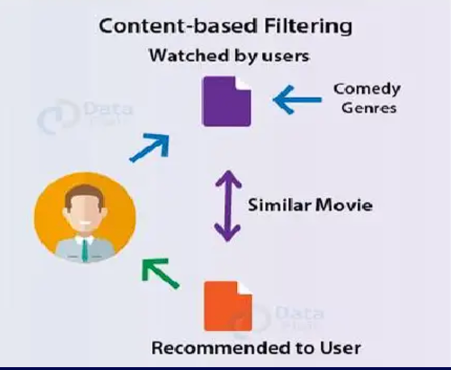
Content- Based Filtering
Content-based filtering approaches uses a series of discrete characteristics of an item in order to recommend additional items with similar properties. Content-based filtering methods are totally based on a description of the item and a profile of the user’s preferences. It recommends items based on user’s past preferences.

Slide 4
Methodologies
Preferred Technologies
• For User Interface: python, Jupyter notebook
• For Backend: NLP ,Machine Learning
• Algorithms : KNN, Naives Bayes Classifier, Cosine Similarity

Slide 5
Project Flow
Colleting Data
Preprocessing
Model
Website
Deploy

Slide 6
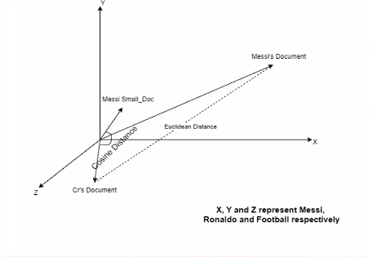
Tags and Vectors
Tags:
Tagging is very useful for users to figure out other users with similar interests within a given category. Users with similar interests might post similar tags and similar resources might have similar tags posted to them. Collaborative filtering is widely used in automatic prediction system.
Vectors:
One simple way is to compute a user vector as an average of the movie vectors that they've seen. These user vectors can represent the user's profile of movie preferences.

Slide 7
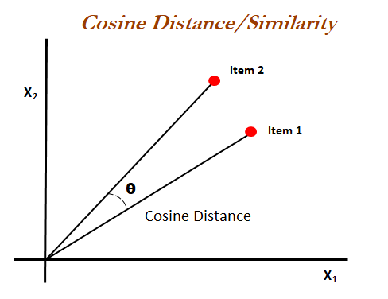
How Cosine Similarity works?
Cosine similarity is a metric used to measure how similar the documents are irrespective of their size. Mathematically, it measures the cosine of the angle between two vectors projected in a multi-dimensional space. The cosine similarity is advantageous because even if the two similar documents are far apart by the Euclidean distance (due to the size of the document), chances are they may still be oriented closer together. The smaller the angle, higher the cosine similarity

Slide 8

Architecture
Recommendation app
Front-End
TMDB API CELLS
TMDB
HTML
Get similar
movies
Python’s Flask
Get similar movies with cosine similarity
CSS
Processed Dataset

Slide 9

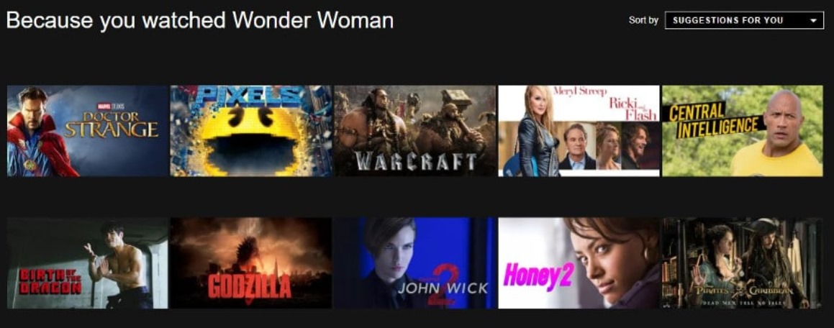
Existing System

Slide 10
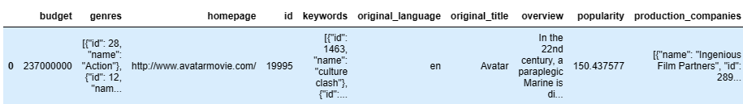
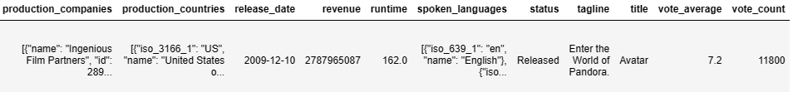
Parameters

Slide 11
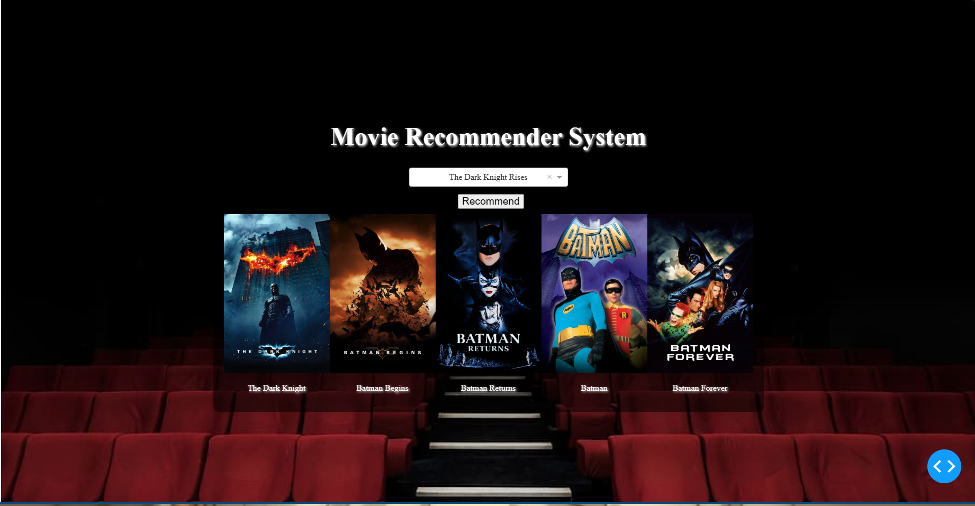
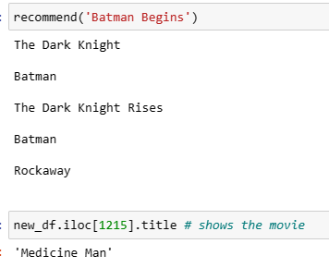
Output

Slide 12
THANK YOU!

